Slide 1
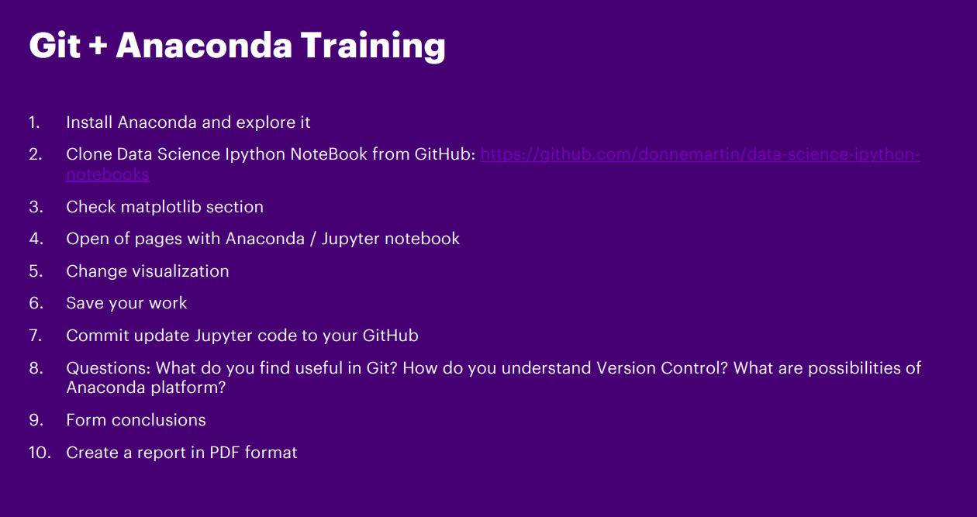

Slide 2
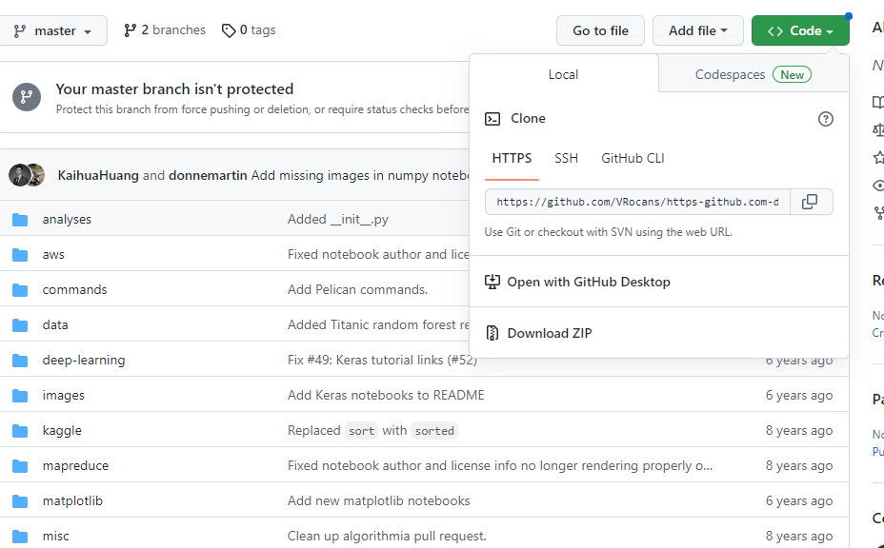

Slide 3
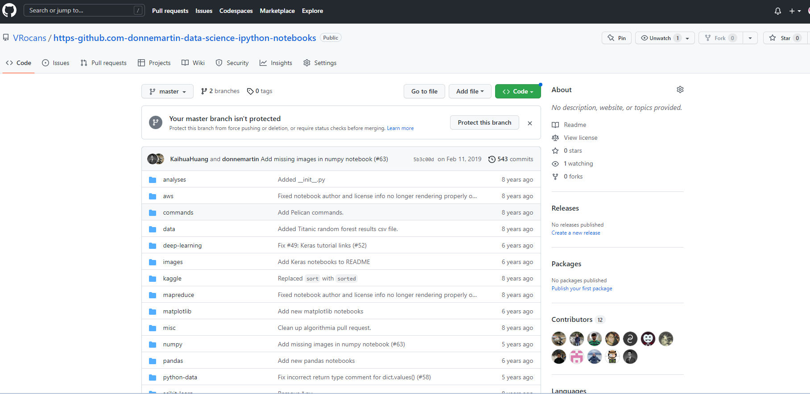

Slide 4
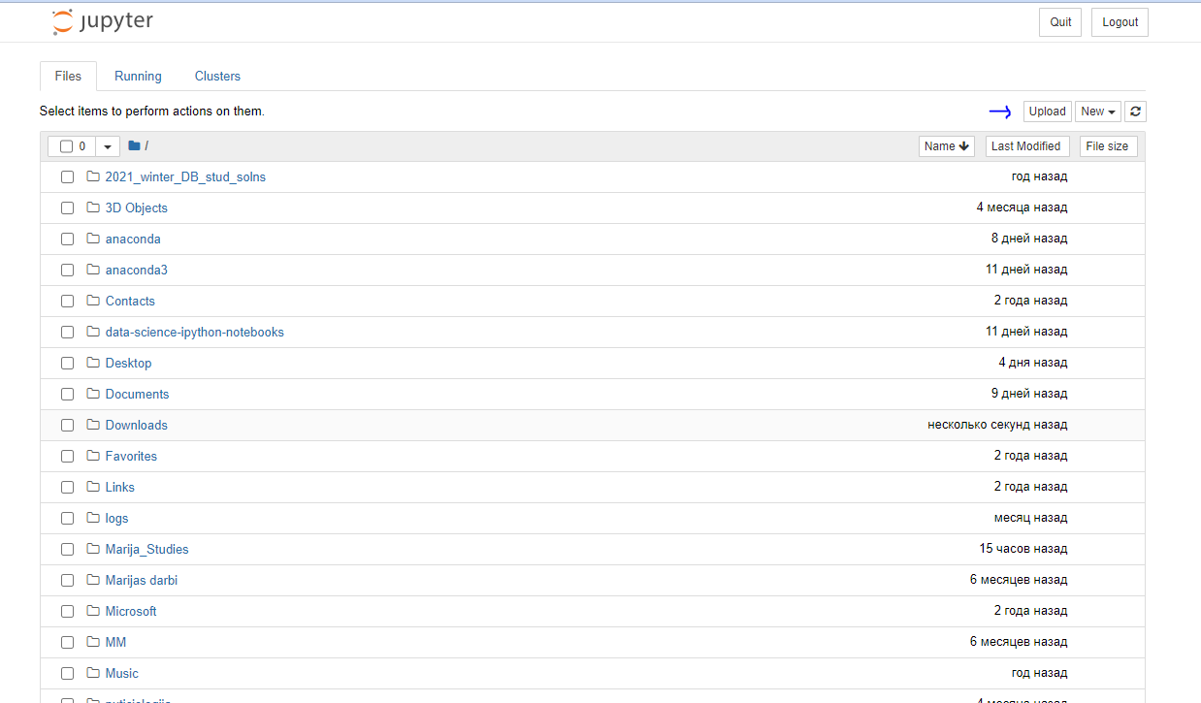

Slide 5
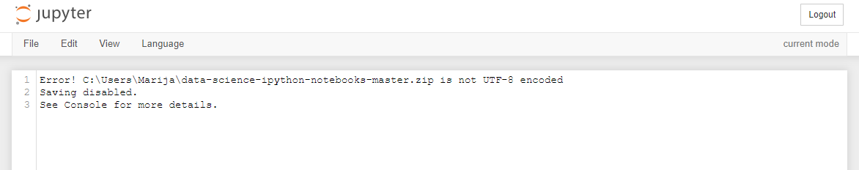

Slide 6
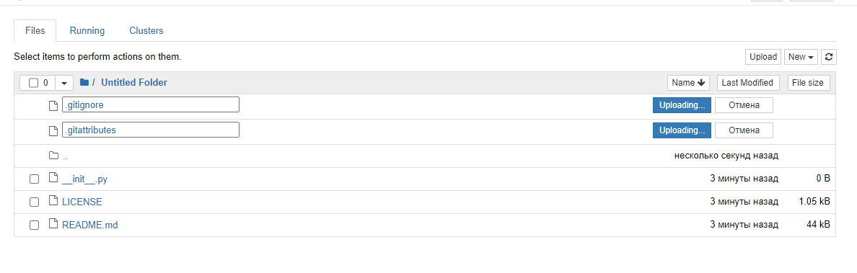

Slide 7
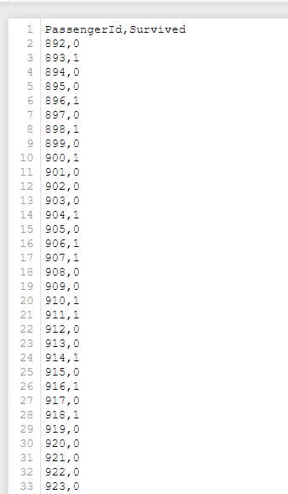
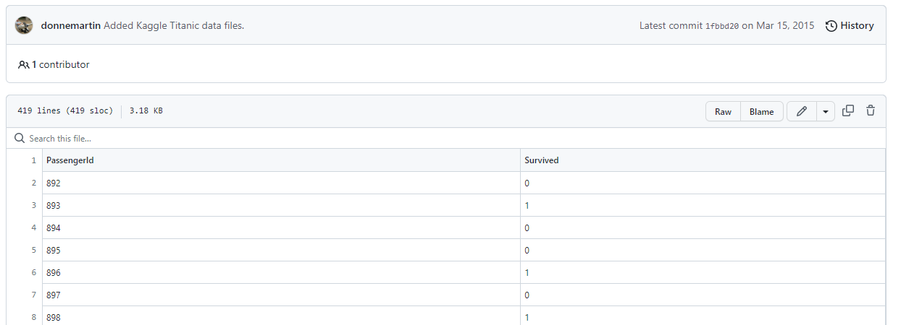

Slide 8
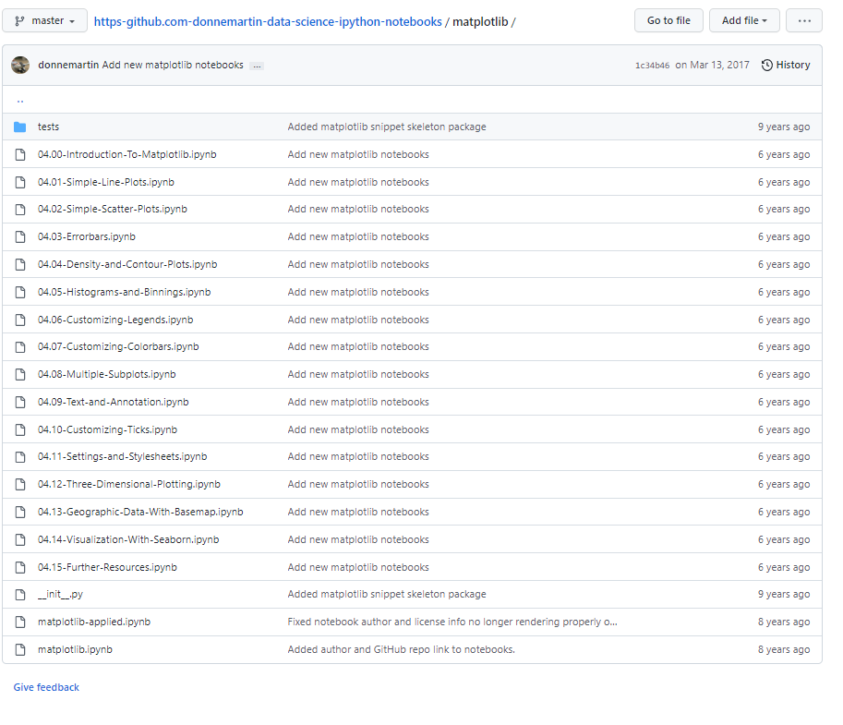
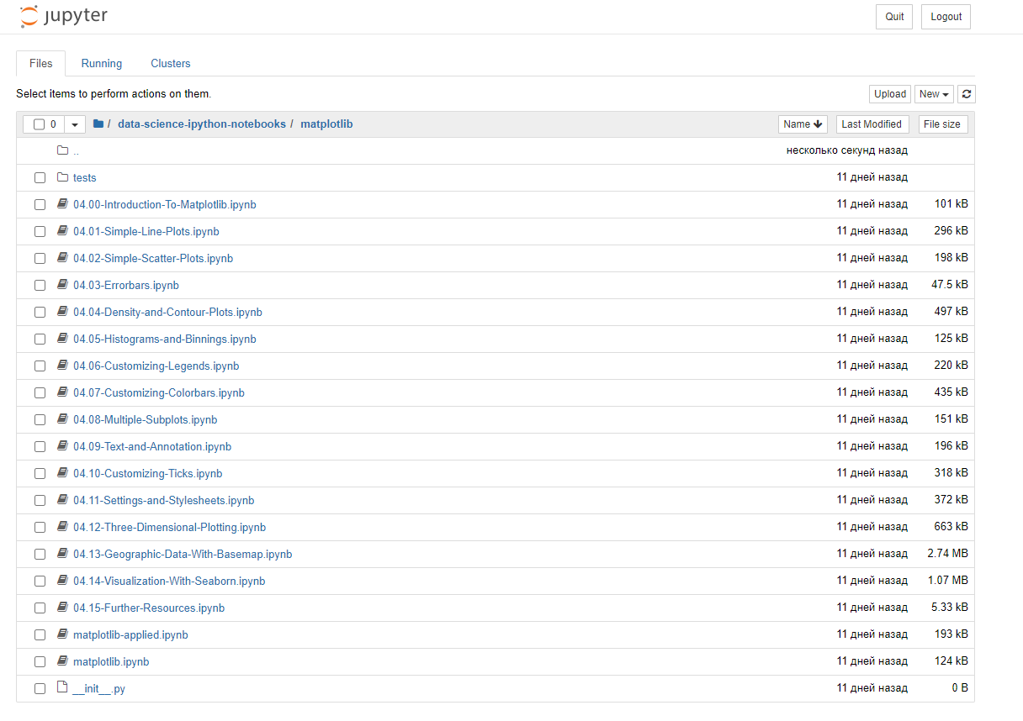

Slide 9
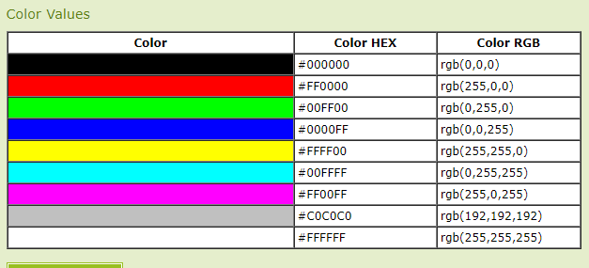
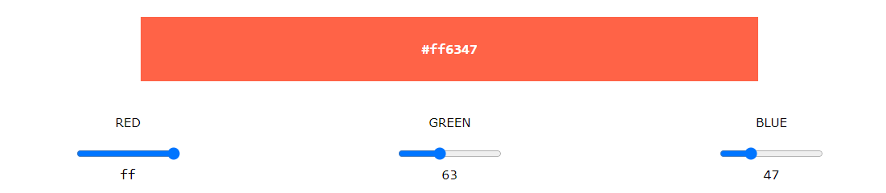
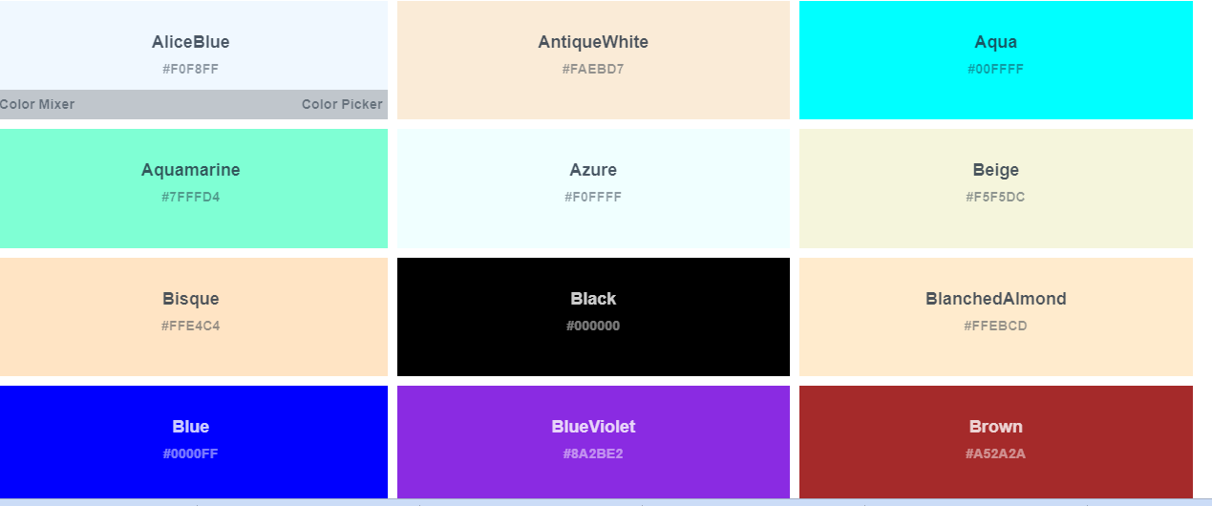
Line Colors and Styles plt.plot()
Color changing:
Can be used words like or short color code
green, black, red…. or g,b,r
Numbers:
0.75-Grayscale between 0 and 1
Hexadecimal value: #RRGGBB
RGB tuple, values 0 to 1
HTML colors names:

Slide 10
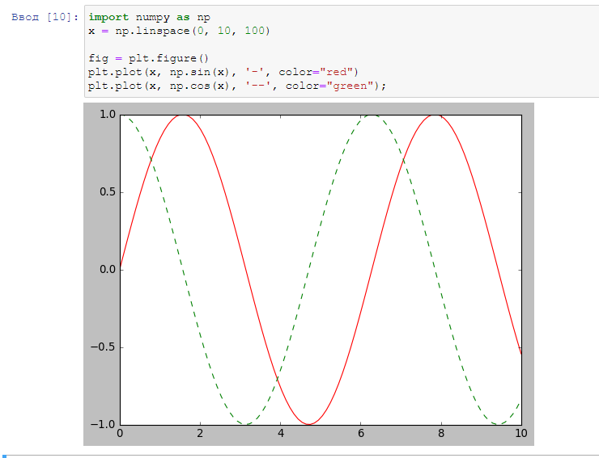
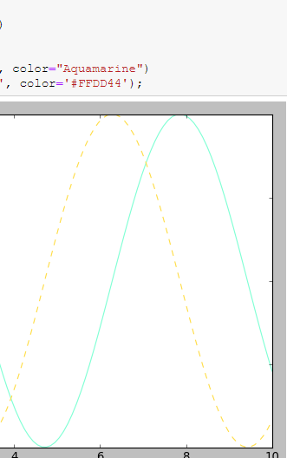
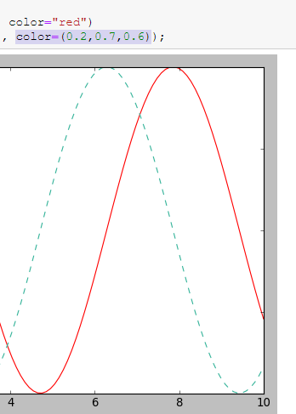

Slide 11
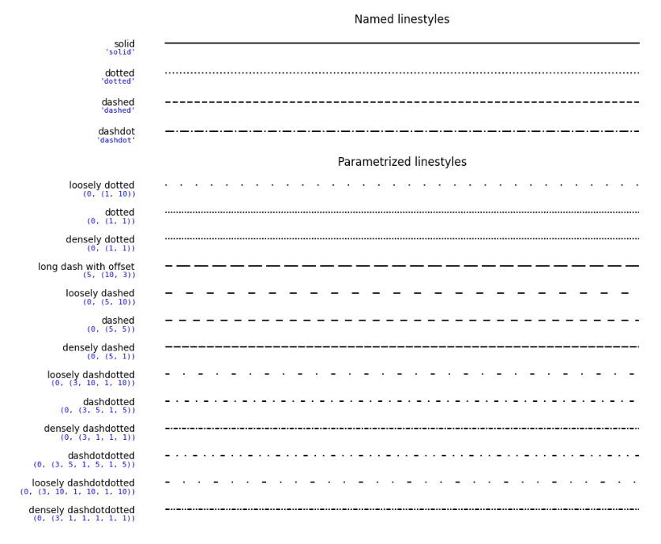

Slide 12
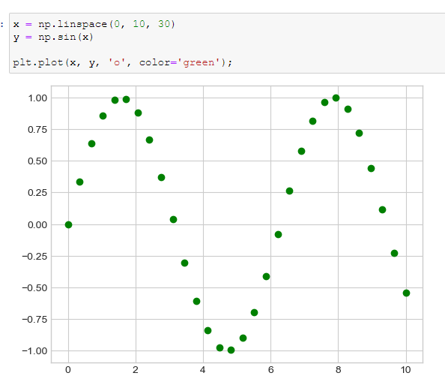
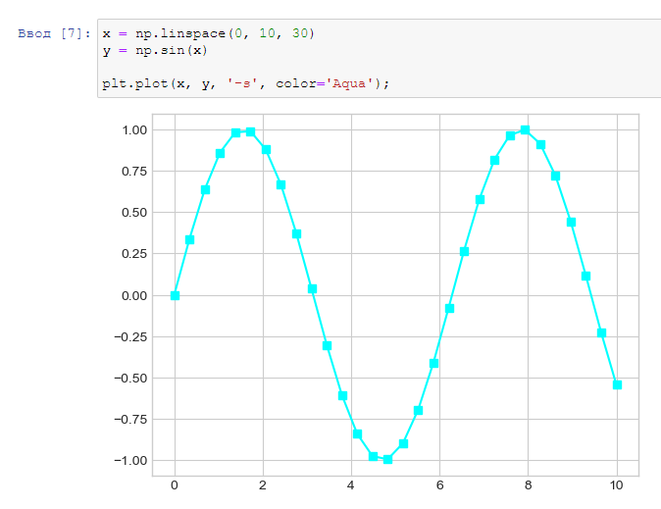
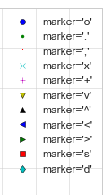

Slide 13
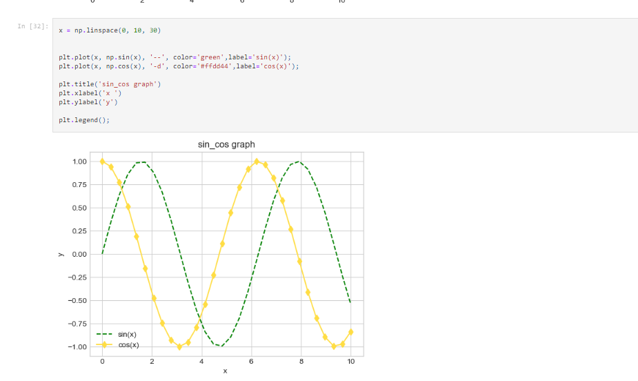

Slide 14
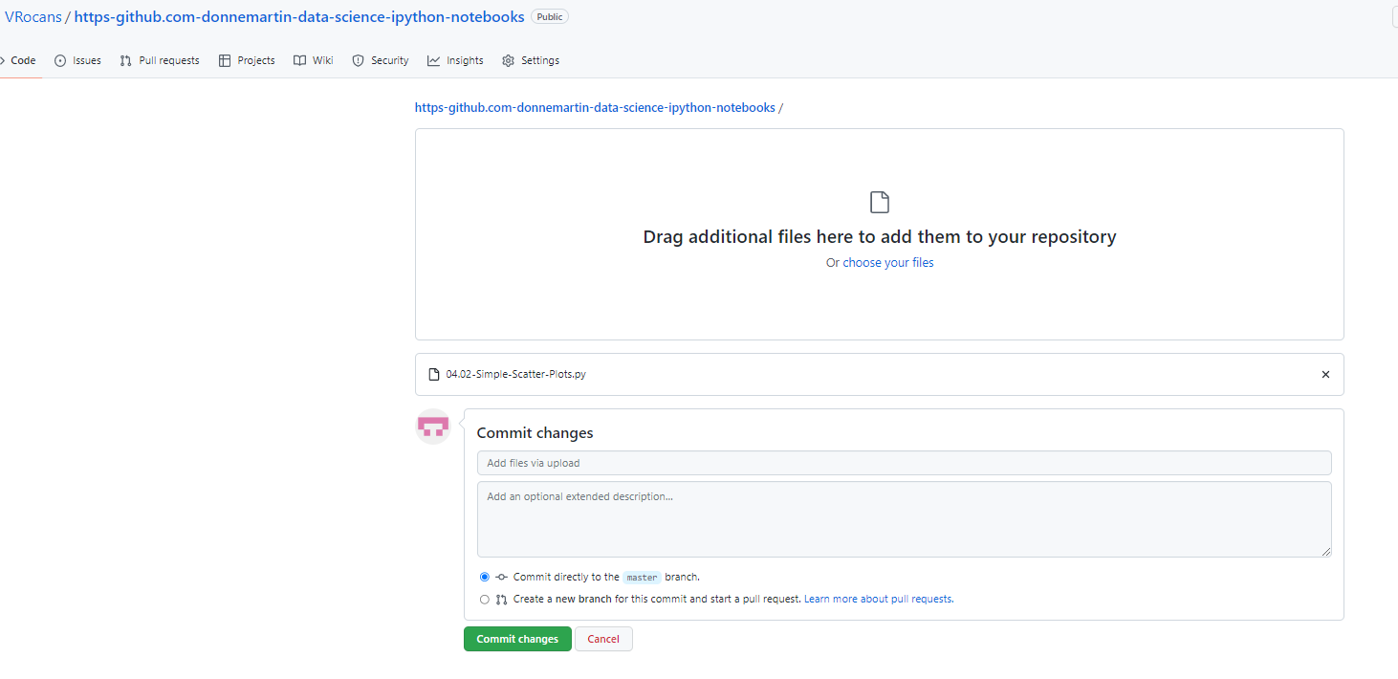

Slide 15
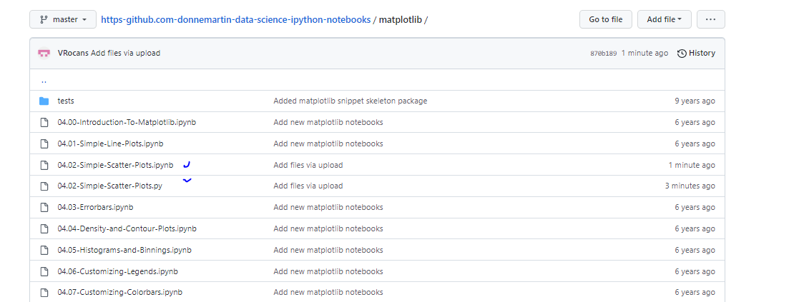

Slide 17
Git is a version control system widely used for software development and other collaborative projects. It allows multiple people to work on a project at the same time and keeps track of all changes made to the code over time.
Questions: What do you find useful in Git? How do you understand Version Control? What are possibilities of Anaconda platform?
Distributed version control: Git allows multiple people to work on a project and share changes, making it easier to collaborate with others.
Version control is a system that tracks changes to a code base over time. The idea of ​​version control is to keep track of all changes to the code base so that you can revert to previous versions if necessary. This is especially useful in a team setting where multiple people may be working on the same code base.
Anaconda is a data science and machine learning platform that provides a variety of tools for data analysis, visualization, and modeling. It includes packages for numerical computing, data processing, and machine learning, as well as tools for managing and deploying these packages.

